Slide 1
Focus Question: How did the American people and government deal with their fear of atomic war and fear of communism during the Cold War?
Do Now:
List the Cold War events we have studied that could have caused Americans to fear the possibility of atomic war and fear the spread of communism.

Slide 2
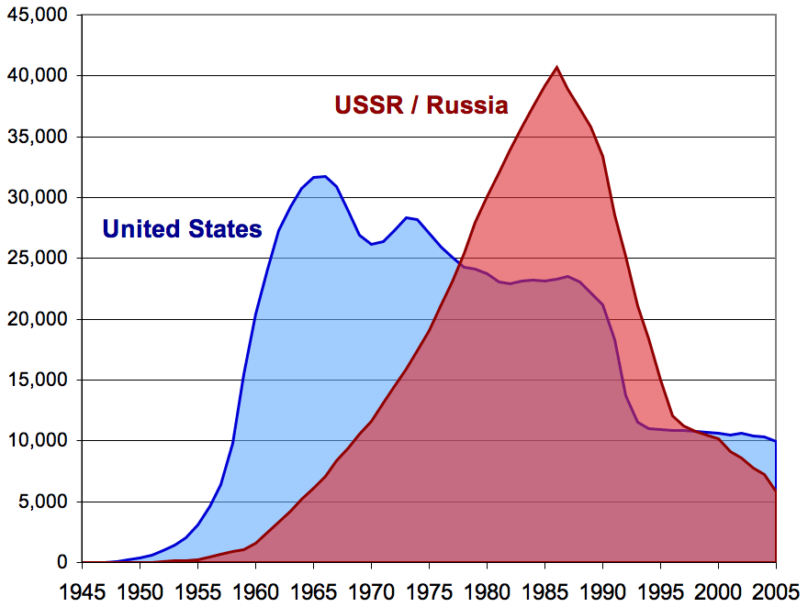
The Arms Race
US & USSR Nuclear Weapon Stockpiles

Slide 3
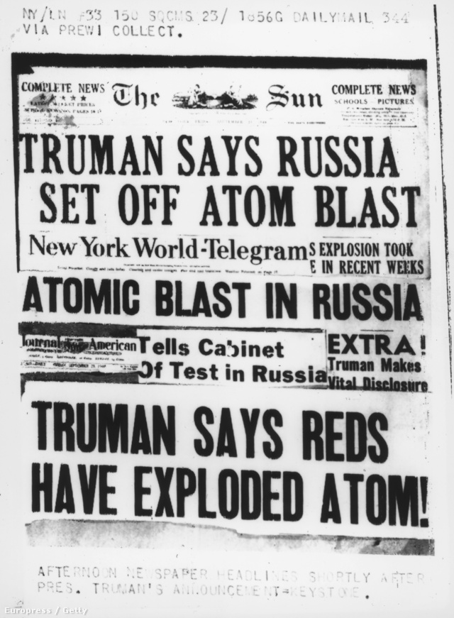
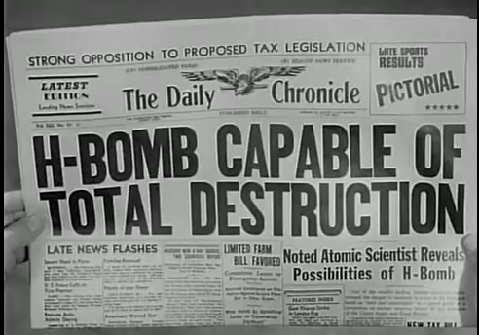
The Arms Race
Newspaper headlines about Soviet bombs

Slide 4
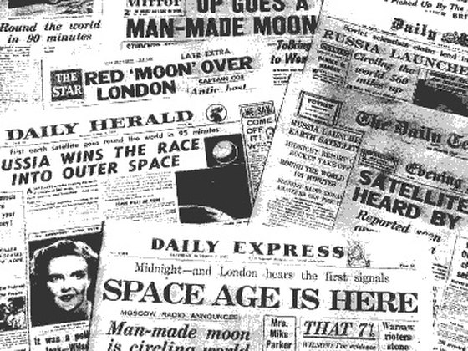
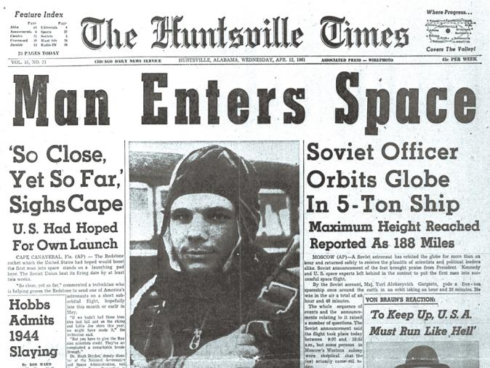
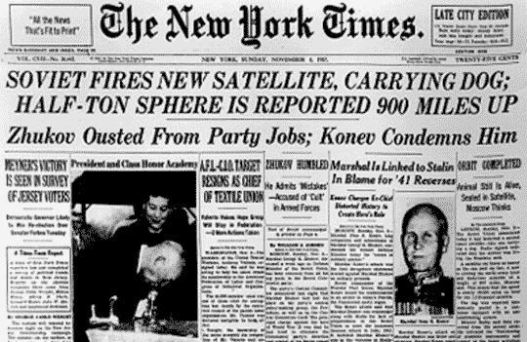
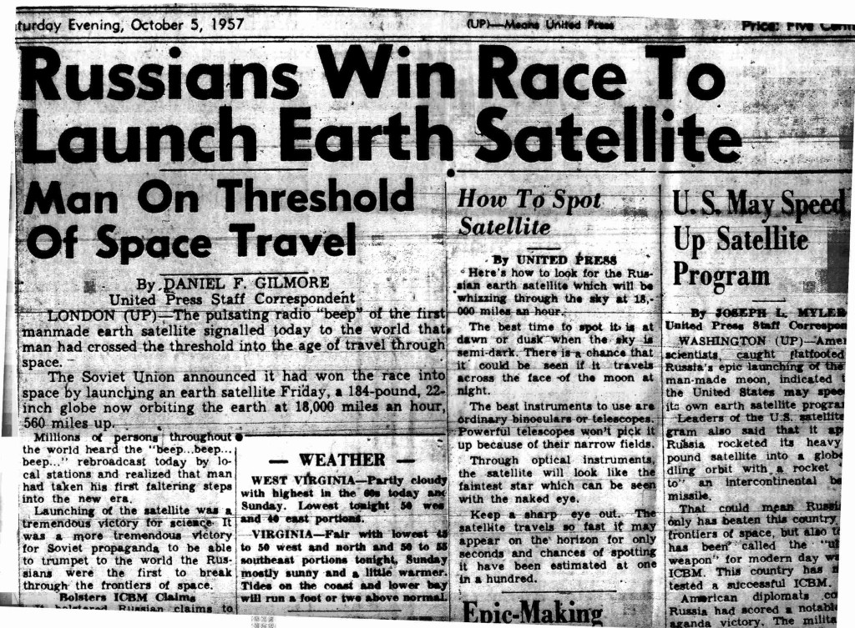
The Space Race
“Space race” newspaper headlines

Slide 5
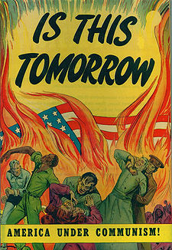
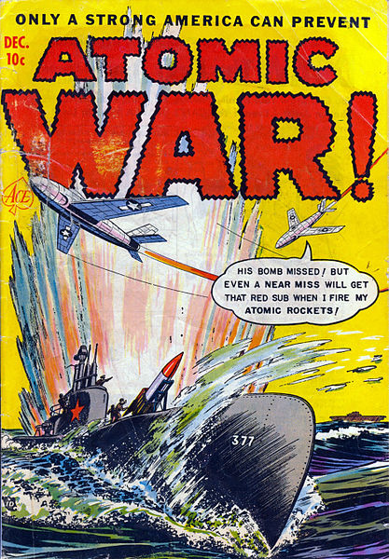
The Fear of Communism & War
A 1947 comic book warning of “the dangers of a Communist takeover”
1952 comic book cover

Slide 6
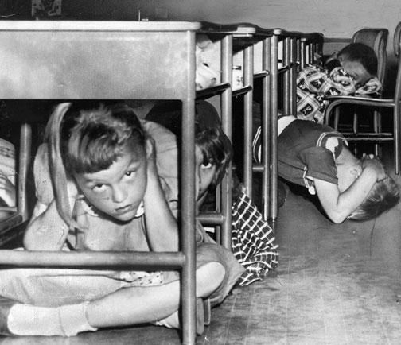
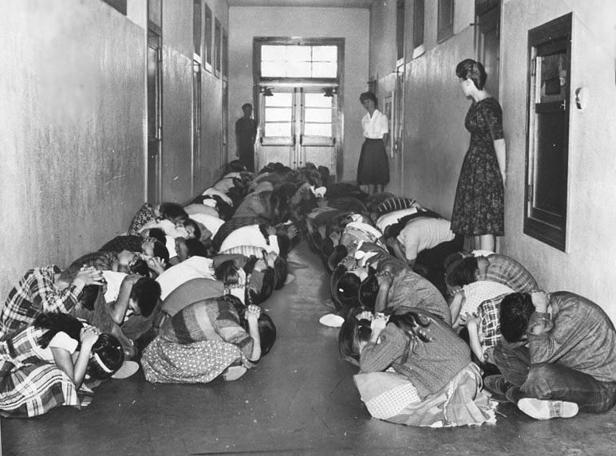
“Duck and Cover”

Slide 7
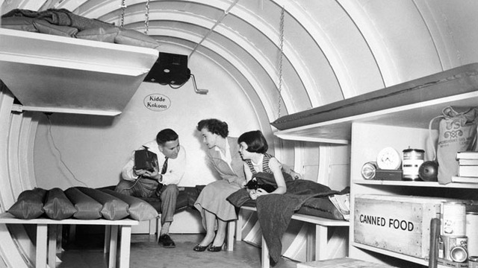
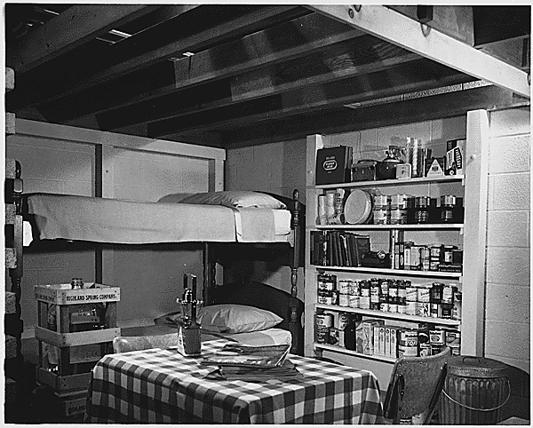
A 1950s Backyard Bomb Shelter

Slide 8
