Slide 1
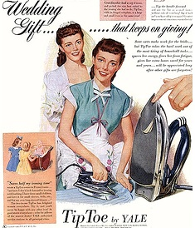
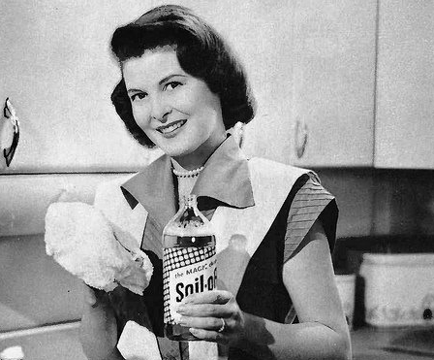
Focus Question: Is the image of the happy 1950s housewife accurate?
Do Now: Look at these images that were printed in popular magazines in the 1950s. According to these images, what do you think life was like for suburban women in the 1950s?
A 1950s ad for an electric iron
A 1950s ad for a cleaning product

Slide 2
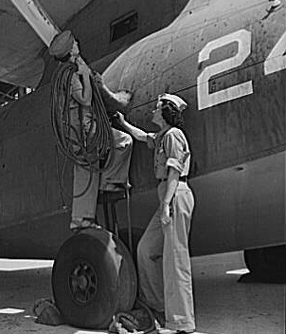
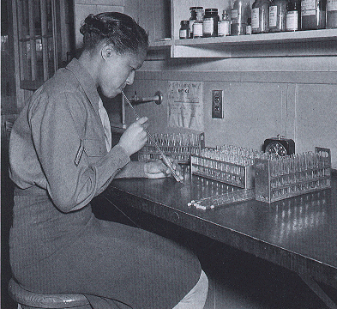
WW II employment for women
Women’s Auxiliary Corps laboratory technician conducts and experiment at Fort Jackson State Hospital, 1944
Aircraft engine technician and senior supervisor, Naval Air Base, 1942

Slide 3
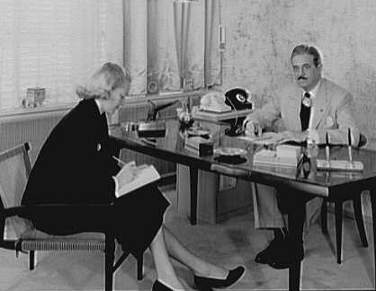
Post-WW II employment
A secretary and her boss, an industrial designer, New York City, 1950

Slide 4
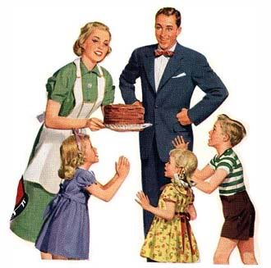
Social pressures
Early marriage
Childbearing
Stay-at-home motherhood
Nuclear family
Image from 1950s ad for cake mix

Slide 5
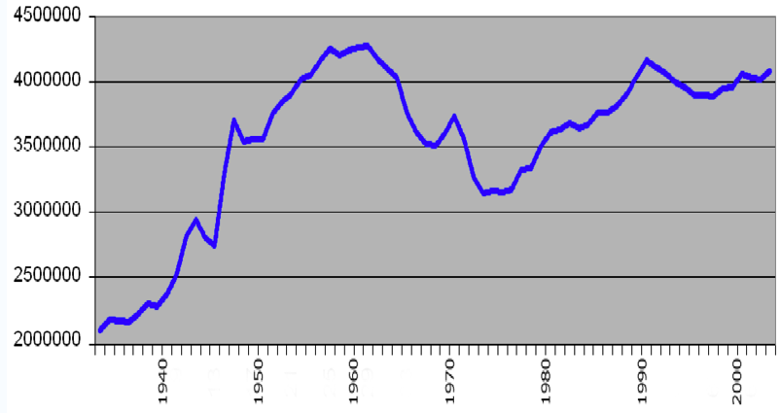
The Baby Boom
Births
Year

Slide 6
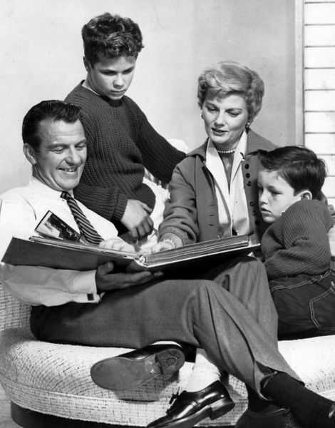
Media portrayals of gender
A photo of the Cleaver family from Leave It To Beaver, a popular TV show in the 1950s and 1960s

Slide 7
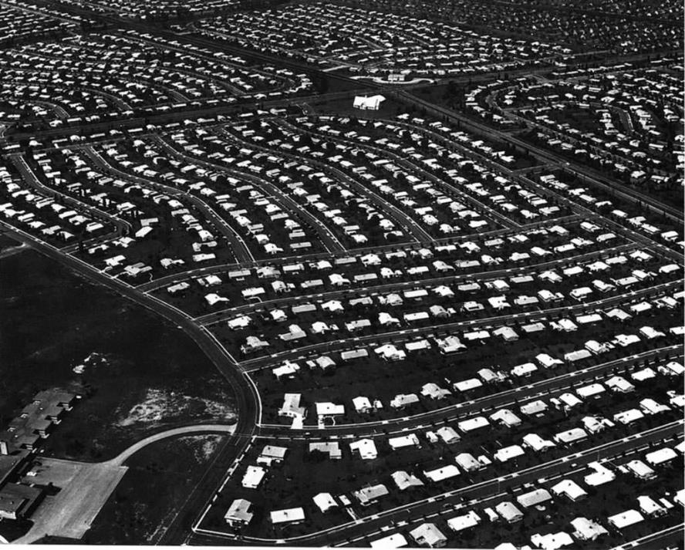
Suburbia, home of the “happy housewife”
G.I. Bill
Mass-produced, affordable homes
Second Great Migration and “white flight”
The planned community of
Levittown, NY, around 1950

Slide 8
Household products marketed to women
A 1950s ad for a cleaning product
A 1950s ad for an electric iron

